Slide 1

The Scrum-agile Approach
Richard Wood

Slide 2



Agenda
Introducing the various roles on a Scrum-agile Team
The various phases of the SDLC work in an agile approach
Agile in contrast to the waterfall model
The pros and cons of both models

Slide 3




Introducing the Scrum-team
The Scrum-agile approach uses a team that consists of four main roles
The Product Owner
The Scrum Master
Testers (could be more then one)
Developers (could be more then one)

Slide 4

The Product Owner
Directs the team on the product
Prioritizes the tasks to be done
Optimizes the value of the product and work of the development team
Has the final “say” in terms of product direction

Slide 5

The Scrum Master
Ensuring effective Product Backlog management
Helping the development team by maximizing their efficiency
Removes obstacles that effects the performance of the development team
Facilitates Scrum Events

Slide 6

The Tester(s)
Defining acceptance criteria and acceptance tests
Clarifies possible confusion found in code and user stories
Executing tests and analyzing the results
Works with team members to resolve issues and defects

Slide 7

The Developer(s)
Designing and developing code following software engineering practices
Code reviews
Collaborating with the team to produce enough design to iterate

Slide 8
Phases of the SDLC work
5 Phases in the SDLC work in an agile approach
Initiation
- The initiation phase of the Scrum framework is the period in which you create a vision of your project.
Planning and Estimation
- This phase involves sprint planning, selecting relevant items from the backlog to move into a sprint backlog
3. Implementation
-This phase is when your team starts implementing the sprint as planned updating the backlog, and reviewing tasks as you work
Reviewing
-This phase is to get feedback from the team and discussing the sprint to figure out stuff you did well and stuff you could improve on
Releasing
-The final phase is when you deliver the product to the stakeholders. After releasing, project retrospectives is a good idea to discuss the overall performance of the project
4.
5.

Slide 9
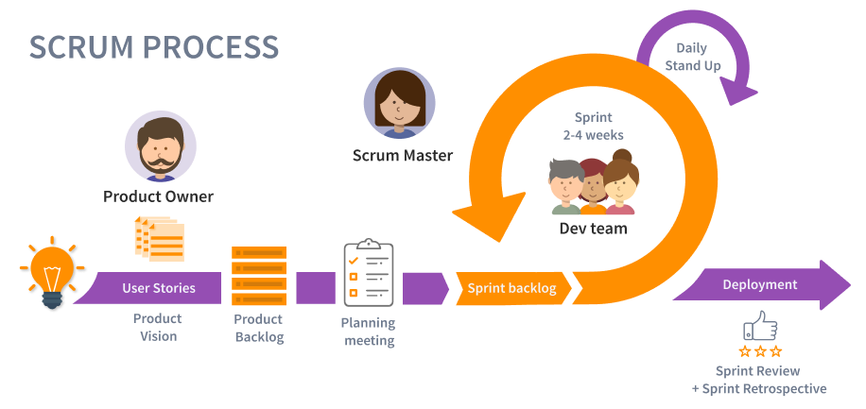
The Scrum Process

Slide 10

The Waterfall Model

Slide 11
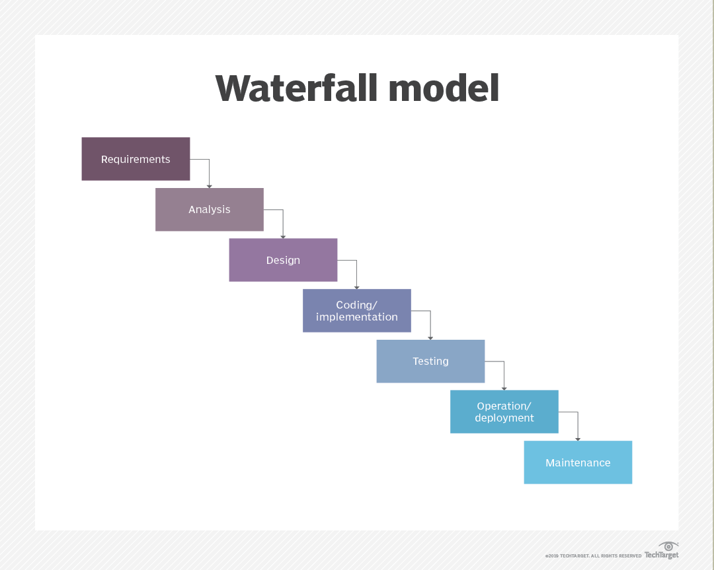
THE WATERFALL MODEL
Composes of seven non-overlapping stages
Requirements: Defining and planning the project without specific processes
Analysis: System specifications are analyzed to generate product models
Design: design specification document is created to outline technical design requirements
Coding/Implementation: Source code is developed using prior documents, models, and requirements from prior stages
Testing: QA, unit, system, and beta tests take place to report issues
Operation/Deployment: When the product is ruled complete, it is deployed live
Maintenance: An indefinite stage to improve, update and enhance the product

Slide 12


Which methodology to choose?
PROS CONS
Adaptive
Large projects are divided into manageable sprints
Clear visibility with scrum events
Adopts feedback from customers and stakeholders
Effective use of time and resources
Individual responsibilities
Lack of definite end-date
Only works when team members are committed and communicate
Team members leaving in the middle of a sprint can cause negative impact
Upfront documentation and planning stages
Disciplined organization
Simple
Defined milestones and deadlines
Good coding habits to define before design then code
Not adaptative
Ignores customer feedback
Does not work when a project changes
Reduces efficiency by the stages not overlapping
No working product is available until the late stages
Not ideal for complex high-risk projects

Slide 13


Thank You
Richard Wood

Slide 14
Sources
5 scrum phases for Project Management (plus benefits). Indeed Career Guide. (n.d.). Retrieved August 14, 2022, from https://www.indeed.com/career-advice/career-development/scrum-phases
Chandana. (2022, January 12). Scrum project management: Advantages and disadvantages. Simplilearn.com. Retrieved August 14, 2022, from https://www.simplilearn.com/scrum-project-management-article
CS250-module two: Initial client meeting. (n.d.). Retrieved August 14, 2022, from http://snhu-media.snhu.edu/files/course_repository/undergraduate/cs/cs250/storyline/mod2/story_html5.html
Davu, S. (2020, April 13). Common problems experienced when adopting agile development. Segue Technologies. Retrieved August 14, 2022, from https://www.seguetech.com/common-problems-experienced-when-adopting-agile-development/
Lewis, S. (2019, February 7). What is waterfall model? - definition from whatis.com. SearchSoftwareQuality. Retrieved August 14, 2022, from https://www.techtarget.com/searchsoftwarequality/definition/waterfall-model
Understanding agile scrum in 10 minutes • tuleap. Tuleap. (2022, July 27). Retrieved August 14, 2022, from https://www.tuleap.org/agile/agile-scrum-in-10-minutes

